Slide 1

Spring Advance

Slide 2

SPRING SECURITY

Slide 3
Spring Security
Sooner or later everyone needs to add security to his project and in the Spring ecosystem you do that with the help of the Spring Security library.
So you go along, add Spring Security to your Spring Boot (or plain Spring) project and suddenly…
…you have auto-generated login-pages.
…you cannot execute POST requests anymore.
…your whole application is on lockdown and prompts you to enter a username and password.

Slide 4
Spring Security
At its core, Spring Security is really just a bunch of servlet filters that help you add authentication and authorization to your web application.
It also integrates well with frameworks like Spring Web MVC (or Spring Boot), as well as with standards like OAuth2 or SAML. And it auto-generates login/logout pages and protects against common exploits like CSRF.
Spring Security is a framework which provides various security features like: authentication, authorization to create secure Java Enterprise Applications.
It is a sub-project of Spring framework which was started in 2003 by Ben Alex. Later on, in 2004, It was released under the Apache License as Spring Security 2.0.0.
It overcomes all the problems that come during creating non spring security applications and manage new server environment for the application.

Slide 5
This framework targets two major areas of application are authentication and authorization:
Authentication is the process of knowing and identifying the user that wants to access
Authorization is the process to allow authority to perform actions in the application.

Slide 6
Spring Security Authentication
Spring Security framework supports wide range of authentication models. These models either provided by third parties or framework itself: HTTP BASIC authentication headers
HTTP Digest authentication headers
HTTP X.509 client certificate exchange
LDAP (Lighweight Directory Access Protocol)
Form-based authentication
OpenID authentication
Automatic remember-me authentication
Kerberos
JOSSO (Java Open Source Single Sign-On)
AppFuse
AndroMDA
Mule ESB
DWR(Direct Web Request)

Slide 7
Spring Security Advantages
Spring Security advantages:
Comprehensive support for authentication and authorization.
Protection against common tasks
Servlet API integration
Integration with Spring MVC
Portability
CSRF protection
Java Configuration support

Slide 8
Spring Security Features
LDAP (Lightweight Directory Access Protocol)
Single sign-on
JAAS (Java Authentication and Authorization Service) LoginModule
Basic Access Authentication
Digest Access Authentication
Remember-me
Web Form Authentication
Authorization
Software Localization
HTTP Authorization

Slide 9
Hashing Algorithms
SHA-256 hash – With cryptographic hashing algorithms, similar inputs produce vastly different outputs. Using the SHA-256 hash generator creates an entirely different hashed output even if only one character is changed.
MD5 (Message Digest Algorithm) – MD5 is a cryptographic algorithm that will always produce an output of 128 bits (typically expressed as a 32 digit hexadecimal number) no matter the length of the input. It was one of the most widely used hashing algorithms but is now no longer recommended.
MD5Crypt – MD5Crypt added extra functionality to MD5 to make it more resistant to brute force attacks. However, in 2012, the author of MD5Crypt, Poul-Hennin Kamp, declared it as insecure due to the speed of modern hardware.
SHA-1 – SHA-1 suffers from many of the same problems as MD5; it’s very fast, it’s also experienced collision attacks, and is now considered unsafe. Faster computations result in faster brute force attacks, making SHA-1 inherently insecure for storing passwords.
BCrypt – Unlike SHA-1 and MD5, Bcrypt is intentionally slow, which is a good thing when it comes to password security as it limits the attacker’s ability to perform successful brute force attacks. A key aspect of hashing is that it should be a one-way form of encryption.

Slide 10
Web Application Security
There are three important concepts to understand
Authentication
Authorization
Servlet Filters

Slide 11
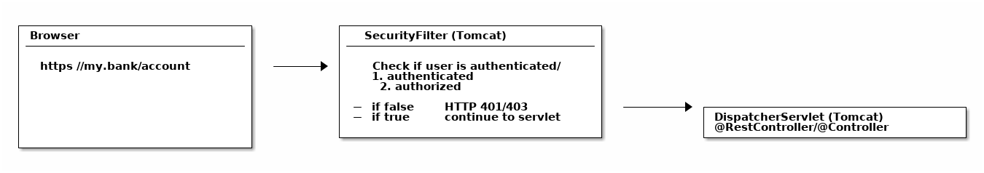
SecurityFilter
In the Java web world: you can put filters in front of servlets, which means you could think about writing a SecurityFilter and configure it in your Tomcat (servlet container/application server) to filter every incoming HTTP request before it hits your servlet.

Slide 12
A naive SecurityFilter
A SecurityFilter has roughly 4 tasks and a naive and overly-simplified implementation could look like this:
First, the filter needs to extract a username/password from the request. It could be via a Basic Auth HTTP Header, or form fields, or a cookie, etc.
Then the filter needs to validate that username/password combination against something, like a database.
The filter needs to check, after successful authentication, that the user is authorized to access the requested URI.
If the request survives all these checks, then the filter can let the request go through to your DispatcherServlet, i.e. your @Controllers.

Slide 13
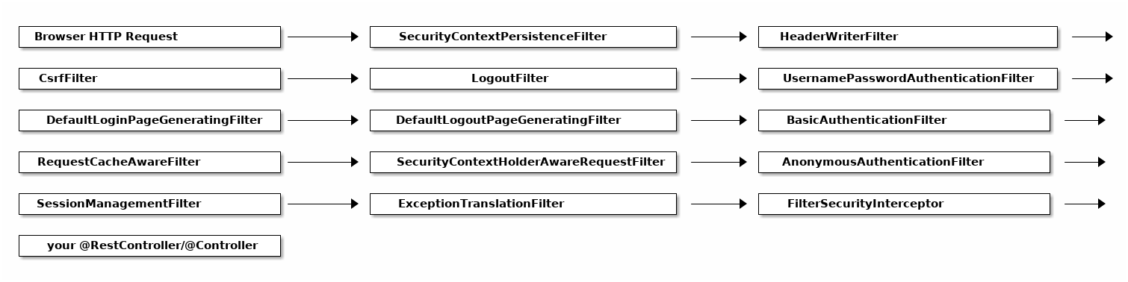
FilterChains

Slide 14
Analyzing Spring’s FilterChain
It would go too far to have a detailed look at every filter of this chain, but here’s the explanations for a few of those filters.
BasicAuthenticationFilter: Tries to find a Basic Auth HTTP Header on the request and if found, tries to authenticate the user with the header’s username and password.
UsernamePasswordAuthenticationFilter: Tries to find a username/password request parameter/POST body and if found, tries to authenticate the user with those values.
DefaultLoginPageGeneratingFilter: Generates a login page for you, if you don’t explicitly disable that feature. THIS filter is why you get a default login page when enabling Spring Security.
DefaultLogoutPageGeneratingFilter: Generates a logout page for you, if you don’t explicitly disable that feature.
FilterSecurityInterceptor: Does your authorization.

Slide 15
How to configure Spring Security: WebSecurityConfigurerAdapter
With the latest Spring Security and/or Spring Boot versions, the way to configure Spring Security is by having a class that:
Is annotated with @EnableWebSecurity.Extends WebSecurityConfigurer, which basically offers you a configuration DSL/methods. With those methods, you can specify what URIs in your application to protect or what exploit protections to enable/disable.

Slide 16
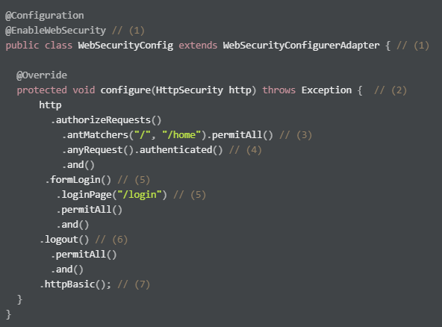
WebSecurityConfigurerAdapter

Slide 17
A normal Spring @Configuration with the @EnableWebSecurity annotation, extending from WebSecurityConfigurerAdapter.
By overriding the adapter’s configure(HttpSecurity) method, you get a nice little DSL with which you can configure your FilterChain.
All requests going to / and /home are allowed (permitted) - the user does not have to authenticate. You are using an antMatcher, which means you could have also used wildcards (, \\*, ?) in the string.
Any other request needs the user to be authenticated first, i.e. the user needs to login.
You are allowing form login (username/password in a form), with a custom loginPage (/login, i.e. not Spring Security’s auto-generated one). Anyone should be able to access the login page, without having to log in first (permitAll; otherwise we would have a Catch-22!).
The same goes for the logout page
On top of that, you are also allowing Basic Auth, i.e. sending in an HTTP Basic Auth Header to authenticate.

Slide 18
What is important for now, is that THIS configure method is where you specify:
What URLs to protect (authenticated()) and which ones are allowed (permitAll()).Which authentication methods are allowed (formLogin(), httpBasic()) and how they are configured.In short: your application’s complete security configuration.
To access any URI (anyRequest()) on your application, you need to authenticate (authenticated()).Form Login (formLogin()) with default settings is enabled.As is HTTP Basic authentication (httpBasic()).
This default configuration is why your application is on lock-down, as soon as you add Spring Security to it.

Slide 19
Authentication with Spring Security
When it comes to authentication and Spring Security you have roughly three scenarios:
The default: You can access the (hashed) password of the user, because you have his details (username, password) saved in e.g. a database table.
Less common: You cannot access the (hashed) password of the user. This is the case if your users and passwords are stored somewhere else, like in a 3rd party identity management product offering REST services for authentication.
Also popular: You want to use OAuth2 or "Login with Google/Twitter/etc." (OpenID), likely in combination with JWT.

Slide 20
Secenario 1: UserDetailsService: Having access to the user’s password
Imagine you have a database table where you store your users. It has a couple of columns, but most importantly it has a username and password column, where you store the user’s hashed(!) password.
In this case Spring Security needs you to define two beans to get authentication up and running.
A UserDetailsService.
A PasswordEncoder.

Slide 21
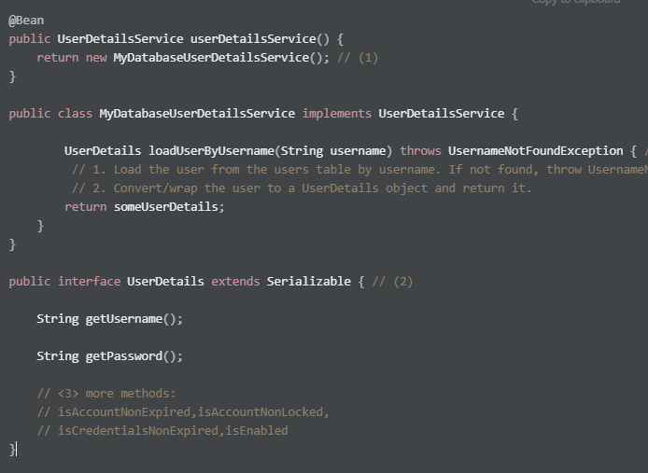

Slide 22
A UserDetailsService loads UserDetails via the user’s username. Note that the method takes only one parameter: username (not the password).
The UserDetails interface has methods to get the (hashed!) password and one to get the username.
UserDetails has even more methods, like is the account active or blocked, have the credentials expired or what permissions the user has - but we won’t cover them here.

Slide 23
Off-The-Shelf Implementations
You can always implement the UserDetailsService and UserDetails interfaces yourself.
But, you’ll also find off-the-shelf implementations by Spring Security that you can use/configure/extend/override instead.
JdbcUserDetailsManager, which is a JDBC(database)-based UserDetailsService. You can configure it to match your user table/column structure.
InMemoryUserDetailsManager, which keeps all userdetails in-memory and is great for testing.
org.springframework.security.core.userdetail.User, which is a sensible, default UserDetails implementation that you could use. That would mean potentially mapping/copying between your entities/database tables and this user class. Alternatively, you could simply make your entities implement the UserDetails interface.

Slide 24
PasswordEncoders
Spring Security cannot magically guess your preferred password hashing algorithm. That’s why you need to specify another @Bean, a PasswordEncoder. If you want to, say, use the BCrypt password hashing function (Spring Security’s default) for all your passwords, you would specify this @Bean in your SecurityConfig.
@Bean
public BCryptPasswordEncoder bCryptPasswordEncoder() {
return new BCryptPasswordEncoder();
}

Slide 25
Full UserDetails Workflow: HTTP Basic Authentication
Now think back to your HTTP Basic Authentication, that means you are securing your application with Spring Security and Basic Auth. This is what happens when you specify a UserDetailsService and try to login:
Extract the username/password combination from the HTTP Basic Auth header in a filter. You don’t have to do anything for that, it will happen under the hood.
Call your MyDatabaseUserDetailsService to load the corresponding user from the database, wrapped as a UserDetails object, which exposes the user’s hashed password.
Take the extracted password from the HTTP Basic Auth header, hash it automatically and compare it with the hashed password from your UserDetails object. If both match, the user is successfully authenticated.

Slide 26
Summary: Having access to the user’s password
The takeaway for this section is: if you are using Spring Security and have access to the user’s password, then:
Specify a UserDetailsService. Either a custom implementation or use and configure one that Spring Security offers.
Specify a PasswordEncoder.
That is Spring Security authentication in a nutshell.

Slide 27
Secenario 2: AuthenticationProvider: Not having access to the user’s password
Now, imagine that you are using Atlassian Crowd for centralized identity management. That means all your users and passwords for all your applications are stored in Atlassian Crowd and not in your database table anymore.
This has two implications:
You do not have the user passwords anymore in your application, as you cannot ask Crowd to just give you those passwords.
You do, however, have a REST API that you can login against, with your username and password. (A POST request to the /rest/usermanagement/1/authentication REST endpoint).
If that is the case, you cannot use a UserDetailsService anymore, instead you need to implement and provide an AuthenticationProvider @Bean.

Slide 28
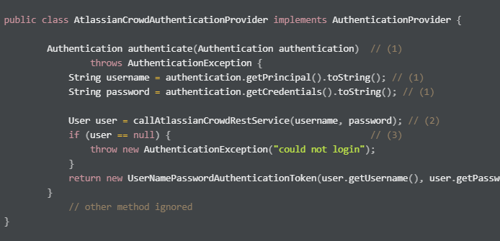

Slide 29
Compared to the UserDetails load() method, where you only had access to the username, you now have access to the complete authentication attempt, usually containing a username and password.
You can do whatever you want to authenticate the user, e.g. call a REST-service.
If authentication failed, you need to throw an exception.
If authentication succeeded, you need to return a fully initialized UsernamePasswordAuthenticationToken. It is an implementation of the Authentication interface and needs to have the field authenticated be set to true (which the constructor used above will automatically set). We’ll cover authorities in the next chapter.

Slide 30
Full AuthenticationProvider Workflow: HTTP Basic Authentication
Now think back to your HTTP Basic Authentication, that means you are securing your application with Spring Security and Basic Auth. This is what happens when you specify an AuthenticationProvider and try to login:
Extract the username/password combination from the HTTP Basic Auth header in a filter. You don’t have to do anything for that, it will happen under the hood.
Call your AuthenticationProvider (e.g. AtlassianCrowdAuthenticationProvider) with that username and password for you to do the authentication (e.g. REST call) yourself.
There is no password hashing or similar going on, as you are essentially delegating to a third-party to do the actual username/password check. That’s AuthenticationProvider authentication in a nutshell!

Slide 31
Summary: AuthenticationProvider
The takeaway for this section is: if you are using Spring Security and do not have access to the user’s password, then implement and provide an AuthenticationProvider @Bean.

Slide 32
Authorization with Spring Security
Take your typical e-commerce web-shop. It likely consists of the following pieces:
The web-shop itself. Let’s assume its URL is www.youramazinshop.com.
Maybe an area for callcenter agents, where they can login and see what a customer recently bought or where their parcel is. Its URL could be www.youramazinshop.com/callcenter.
A separate admin area, where administrators can login and manage callcenter agents or other technical aspects (like themes, performance, etc.) of the web-shop. Its URL could be www.youramazinshop.com/admin.

Slide 33
What are Authorities? What are Roles?
An authority (in its simplest form) is just a string, it can be anything like: user, ADMIN, ROLE_ADMIN or 53cr37_r0l3.
A role is an authority with a ROLE_ prefix. So a role called ADMIN is the same as an authority called ROLE_ADMIN.
The distinction between roles and authorities is purely conceptual and something that often bewilders people new to Spring Security.

Slide 34
Why is there a distinction between roles and authorities?
Honestly, I’ve read the Spring Security documentation as well as a couple of related StackOverflow threads on this very question and I can’t give you a definitive, good answer.

Slide 35
UserDetailsService: Where to store and get authorities?
Assuming you are storing the users in your own application (think: UserDetailsService), you are going to have a Users table.
Now, you would simply add a column called "authorities" to it. I chose a simple string column here, though it could contain multiple, comma-separated values. Alternatively I could also have a completely separate table AUTHORITIES.

Slide 36
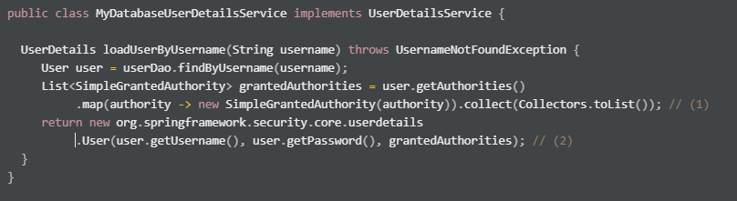
DatabaseUserDetailsService
You simply map whatever is inside your database column to a list of SimpleGrantedAuthorities. Done.
Again, we’re using Spring Security’s base implementation of UserDetails here. You could also use your own class implementing UserDetails here and might not even have to map then.

Slide 37
AuthenticationManager: Where to store and get authorities?
When the users comes from a third-party application, like Atlassian Cloud, you’ll need to find out what concept they are using to support authorities. Atlassian Crowd had the concepts of "roles", but deprecated it in favour of "groups".
So, depending on the actual product you are using, you need to map this to a Spring Security authority, in your AuthenticationProvider.

Slide 38
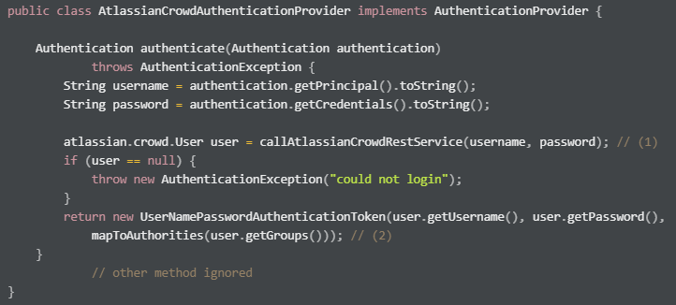

Slide 39
hasAccess and SpEL
We can also use Spring Expression Language (SpEL) in our configure authorization:
http.authorizeRequests()
.antMatchers("/admin").access("
hasRole('admin')
and hasIpAddress('192.168.1.0/24')
and @myCustomBean.checkAccess(authentication,request)
")

Slide 40
Common Exploit Protections
There is a variety of common attacks that Spring Security helps you to protect against. It starts with timing attacks (i.e. Spring Security will always hash the supplied password on login, even if the user does not exist) and ends up with protections against cache control attacks, content sniffing, click jacking, cross-site scripting and more.

Slide 41
Method Security
works through annotations that you can basically put on any public method of your Spring beans. You also need to explicitly enable method security by putting the @EnableGlobalMethodSecurity annotation on your ApplicationContextConfiguration.
@Configuration
@EnableGlobalMethodSecurity(
prePostEnabled = true, // (1)
securedEnabled = true, // (2)
jsr250Enabled = true) // (3)
public class YourSecurityConfig extends WebSecurityConfigurerAdapter{ }

Slide 42
The prePostEnabled property enables support for Spring’s @PreAuthorize and @PostAuthorize annotations. Support means, that Spring will ignore this annotation unless you set the flag to true.
The securedEnabled property enables support for the @Secured annotation. Support means, that Spring will ignore this annotation unless you set the flag to true.
The jsr250Enabled property enables support for the @RolesAllowed annotation. Support means, that Spring will ignore this annotation unless you set the flag to true.

Slide 43
What is the difference between @PreAuthorize, @Secured and @RolesAllowed?
@Secured and @RolesAllowed are basically the same, though @Secured is a Spring-specific annotation coming with the spring-security-core dependency and @RolesAllowed is a standardised annotation, living in the javax.annotation-api dependency. Both annotations take in an authority/role string as value.
@PreAuthorize/@PostAuthorize are also (newer) Spring specific annotations and more powerful than the above annotations, as they can contain not only authorities/roles, but also any valid SpEL expression.

Slide 44
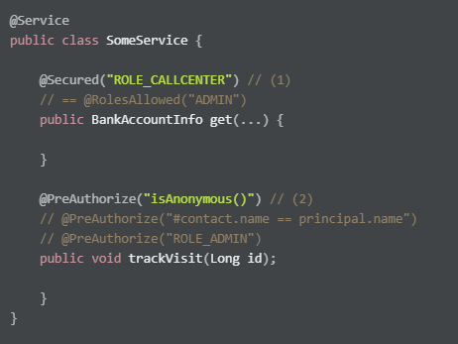

Slide 45
Spring Security & Spring Web MVC
As for the integration with Spring WebMVC, Spring Security allows you to do a couple of things:
In addition to antMatchers and regexMatchers, you can also use mvcMatchers. The difference is, that while antMatchers and regexMatchers basically match URI strings with wildcards, mvcMatchers behave exactly like @RequestMappings.
Injection of your currently authenticated principal into a @Controller/@RestController method.
Injection of your current session CSRFToken into a @Controller/@RestController method.
Correct handling of security for async request processing.

Slide 46
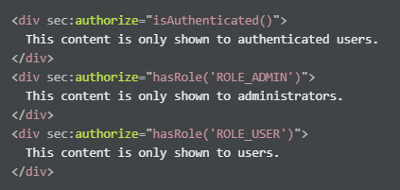
Spring Security & Thymeleaf
Spring Security integrates well with Thymeleaf. It offers a special Spring Security Thymeleaf dialect, which allows you to put security expressions directly into your Thymeleaf HTML templates.

Slide 47
DEMO

Slide 48
OAuth concepts
Resource owner
OAuth client
OAuth server Known as the Authorization server in OAuth 2.0.
Scope
Access token
Bearer token
Protected resource
Resource server
Authorization grant
Authorization code
Refresh token

Slide 49
JWT
JWT(Json Web Token) is a token format. It is digitally-signed, self-contained, and compact. It provides a convenient mechanism for transferring data. JWT is not inherently secure, but the use of JWT can ensure the authenticity of the message so long as the signature is verified and the integrity of the payload can be guaranteed. JWT is often used for stateless authentication in simple use cases involving non-complex systems.
Although JWTs can be encrypted to also provide secrecy between parties, we will focus on signed tokens. Signed tokens can verify the integrity of the claims contained within it, while encrypted tokens hide those claims from other parties. When tokens are signed using public/private key pairs, the signature also certifies that only the party holding the private key is the one that signed it.

Slide 50
When should you use JSON Web Tokens?
Here are some scenarios where JSON Web Tokens are useful:
Authorization: This is the most common scenario for using JWT. Once the user is logged in, each subsequent request will include the JWT, allowing the user to access routes, services, and resources that are permitted with that token. Single Sign On is a feature that widely uses JWT nowadays, because of its small overhead and its ability to be easily used across different domains.
Information Exchange: JSON Web Tokens are a good way of securely transmitting information between parties. Because JWTs can be signed—for example, using public/private key pairs—you can be sure the senders are who they say they are. Additionally, as the signature is calculated using the header and the payload, you can also verify that the content hasn't been tampered with.

Slide 51
What is the JSON Web Token structure?
In its compact form, JSON Web Tokens consist of three parts separated by dots (.), which are:
Header
Payload
Signature
Therefore, a JWT typically looks like the following.
xxxxx.yyyyy.zzzzz

Slide 52
Spring Security JWT implementation
DEMO

Slide 53
Single Sign On
Single sign-on (SSO) is an authentication scheme that allows a user to log in with a single ID and password to any of several related, yet independent, software systems. It is often accomplished by using the Lightweight Directory Access Protocol (LDAP) and stored LDAP databases on (directory) servers. A simple version of single sign-on can be achieved over IP networks using cookies but only if the sites share a common DNS parent domain.

Slide 54
Benefits
Mitigate risk for access to 3rd-party sites (user passwords not stored or managed externally)
Reduce password fatigue from different username and password combinations
Reduce time spent re-entering passwords for the same identity
Reduce IT costs due to lower number of IT help desk calls about passwords
SSO shares centralized authentication servers that all other applications and systems use for authentication purposes and combines this with techniques to ensure that users do not have to actively enter their credentials more than once.

Slide 55
Criticism
The term reduced sign-on (RSO) has been used by some to reflect the fact that single sign-on is impractical in addressing the need for different levels of secure access in the enterprise, and as such more than one authentication server may be necessary.
As single sign-on provides access to many resources once the user is initially authenticated ("keys to the castle"), it increases the negative impact in case the credentials are available to other people and misused. Therefore, single sign-on requires an increased focus on the protection of the user credentials, and should ideally be combined with strong authentication methods like smart cards and one-time password tokens.
Single sign-on also makes the authentication systems highly critical; a loss of their availability can result in denial of access to all systems unified under the SSO. SSO can be configured with session failover capabilities in order to maintain the system operation. Nonetheless, the risk of system failure may make single sign-on undesirable for systems to which access must be guaranteed at all times, such as security or plant-floor systems.

Slide 56
Event Driven Architecture

Slide 57
Event Driven Architecture
The event-driven architecture pattern is a popular distributed asynchronous architecture pattern used to produce highly scalable applications. It is also highly adaptable and can be used for small applications and as well as large, complex ones. The event-driven architecture is made up of highly decoupled, single-purpose event processing components that asynchronously receive and process events.
The event-driven architecture pattern consists of two main topologies, the mediator and the broker. The mediator topology is commonly used when you need to orchestrate multiple steps within an event through a central mediator, whereas the broker topology is used when you want to chain events together without the use of a central mediator. Because the architecture characteristics and implementation strategies differ between these two topologies, it is important to understand each one to know which is best suited for your particular situation.

Slide 58
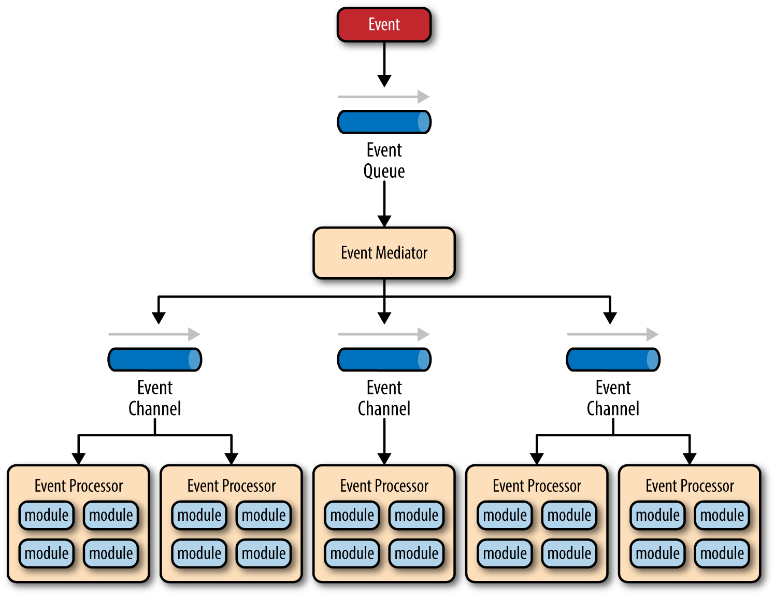
Mediator Topology

Slide 59
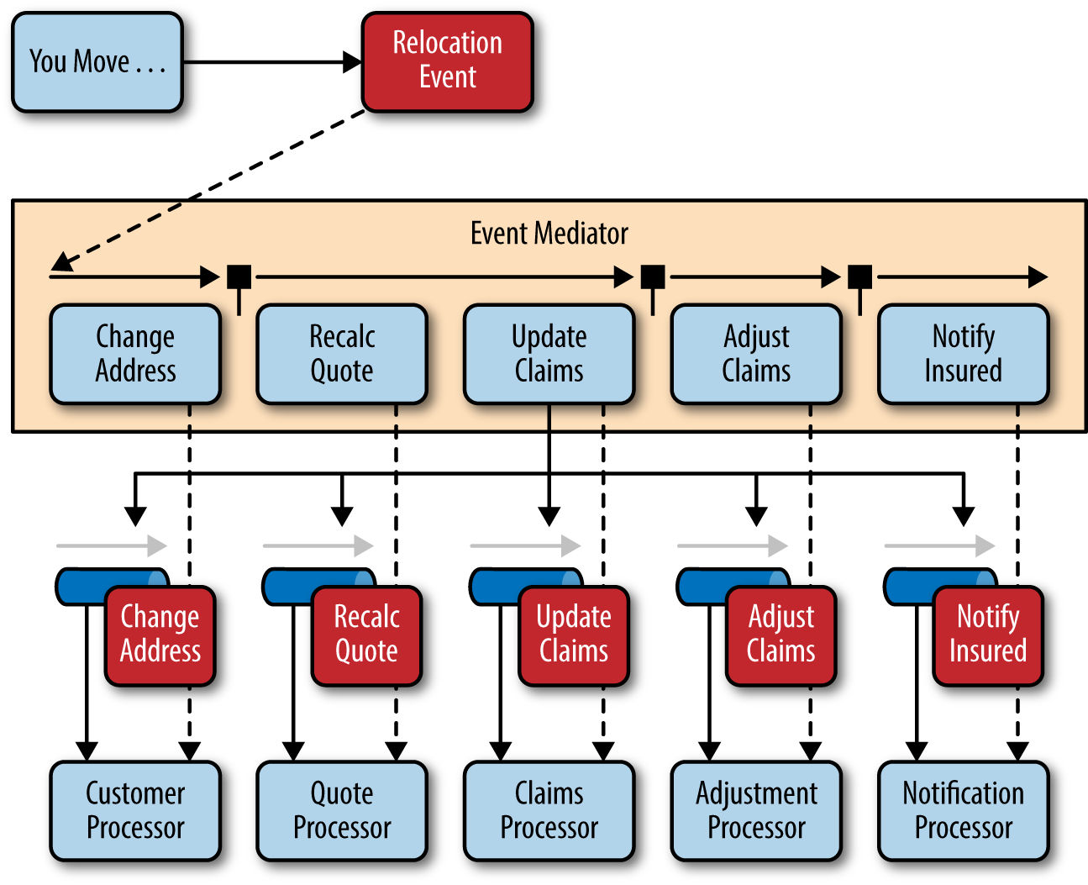
Example Mediator Topology

Slide 60
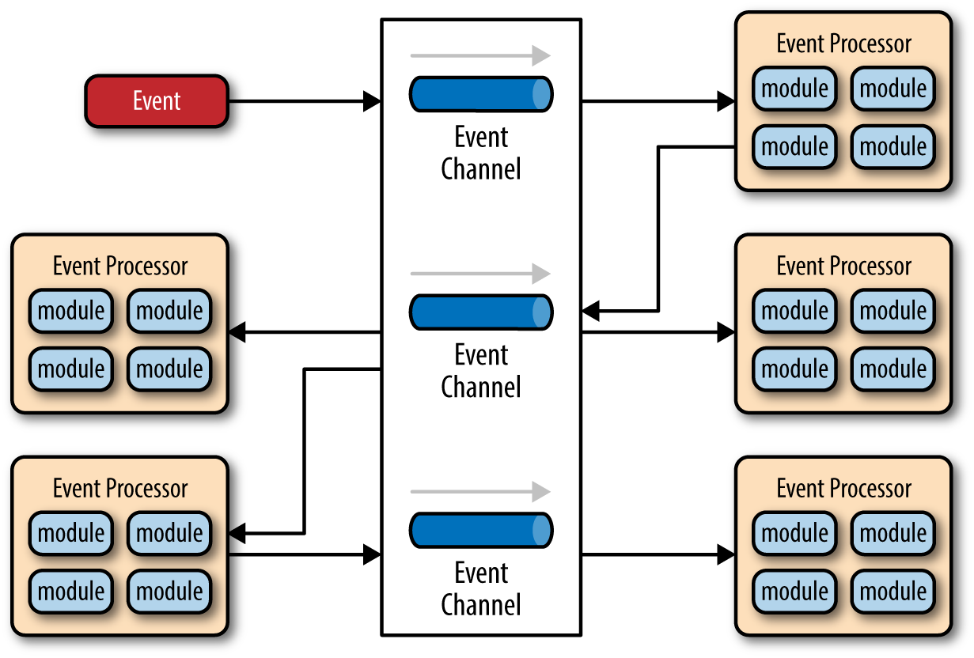
Broker Topology

Slide 61
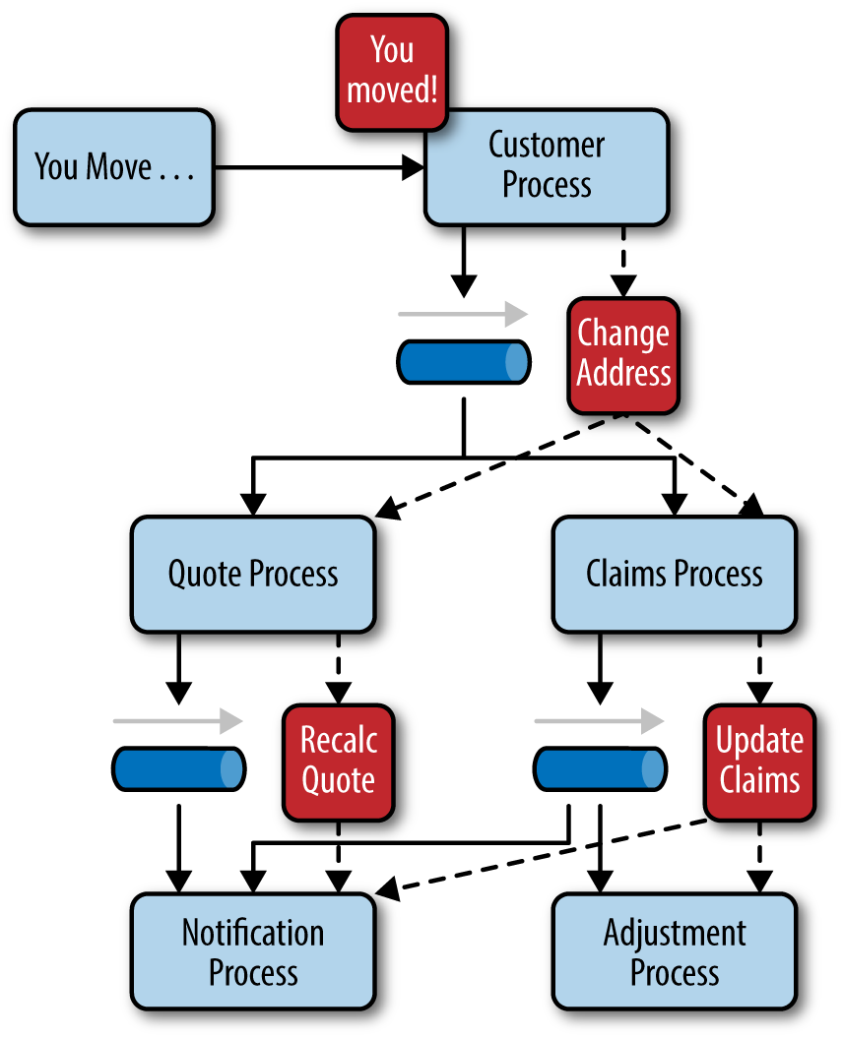
Broker Topology Example

Slide 62
Considerations
The event-driven architecture pattern is a relatively complex pattern to implement, primarily due to its asynchronous distributed nature. When implementing this pattern, you must address various distributed architecture issues, such as remote process availability, lack of responsiveness, and broker reconnection logic in the event of a broker or mediator failure.

Slide 63
Pattern Analysis
Overall agility Rating: High
Ease of deployment Rating: High
Testability Rating: Low.
Performance Rating: High
Scalability Rating: High
Ease of development Rating: Low

Slide 64
JMS (Java Message Service)
JMS (Java Message Service) is an API that provides the facility to create, send and read messages. It provides loosely coupled, reliable and asynchronous communication.
JMS is also known as a messaging service.

Slide 65
JMS application consists of :
JMS Provider: A JMS provider is a communications system that uses JMS interfaces that offers monitoring and control capabilities. Implementation of Java EE application requires a JMS provider.
JMS Clients: They are the programs or components that generate and consume messages, written in Java. Every part of the Java EE framework may serve as a client of JMS.

Slide 66
Messaging Domains
There are two types of messaging domains in JMS.
Point-to-Point Messaging Domain
Publisher/Subscriber Messaging Domain

Slide 67

Point-to-Point (PTP) Messaging Domain
In PTP model, one message is delivered to one receiver only. Here, Queue is used as a message oriented middleware (MOM).
The Queue is responsible to hold the message until receiver is ready.
In PTP model, there is no timing dependency between sender and receiver.

Slide 68
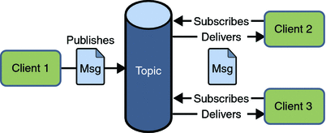
Publisher/Subscriber (Pub/Sub) Messaging Domain
In Pub/Sub model, one message is delivered to all the subscribers. It is like broadcasting. Here, Topic is used as a message oriented middleware that is responsible to hold and deliver messages.
In PTP model, there is timing dependency between publisher and subscriber.

Slide 69
AMQP (Advanced Message Queuing Protocol)
he Advanced Message Queuing Protocol (AMQP) is an open standard for passing business messages between applications or organizations. It connects systems, feeds business processes with the information they need and reliably transmits onward the instructions that achieve their goals.

Slide 70
Key Capabilities
AMQP connects across:
Organizations – applications in different organizations
Technologies – applications on different platforms
Time – systems don’t need to be available simultaneously
Space – reliably operate at a distance, or over poor networks

Slide 71
Key Features
Key Features
AMQP was designed with the following main characteristics as goals:
Security
Reliability
Interoperability
Standard
Open

Slide 72
Differences between AMQP and JMS
JMS is a standard Java API for communicating with Message Oriented Middleware (MOM).
JMS is a part of the Java J2EE, and it's defined by JSR 914. It's considered to be robust and mature.JMS allows two different Java applications to communicate
JMS is a part of the Java J2EE, and it's defined by JSR 914. It's considered to be robust and mature.JMS allows two different Java applications to communicate
One can replace any JMS broker with another with minimal or even non changes in your code.

Slide 73
Differences between AMQP and JMS
AMQP (which stands for 'Advanced Message Queuing Protocol') is kind of an open standard application layer protocol for delivering messages that was initially development by O'Hara from JPMorgan.
AMQP can queue and rout messages. It can go P-2-P (One-2-One), publish/subscribe, and some more, in a manner of reliability and secured way.
If you want AMQP you probably go for RabbitMQ, Qpid or StormMQ.
AMQP provides a description on how a message should be constructed. It doesn't provide an API on how the message should be sent.

Slide 74
JMS Queues, Topics, Durable;
Durable queues keep messages around persistently for any suitable consumer to consume them. Durable queues do not need to concern themselves with which consumer is going to consume the messages at some point in the future. There is just one copy of a message that any consumer in the future can consume.
Durable topics however are different as they must logically persist an instance of each suitable message for every durable consumer - since each durable consumer gets their own copy of the message.

Slide 75
Different types of message brokers
There are three types of message brokers – point-to-point, publish-subscribe, and a hybrid of both. The purpose of a broker is to:
Route or transfer messages to one or more destinations with an alternative representation.
Perform message aggregation, and to decompose them to multiple messages
Sending messages to their destination
Recomposing the responses into one message
Respond to the messages received / errors
Communicate with external repository to augment a message

Slide 76
RabbitMQ
RabbitMQ is the most widely deployed open source message broker. Often termed as message-oriented middleware, this open source software was originally implemented in AMQP (Advanced Message Queuing Protocol) for message orientation, queuing, routing, reliability and security. Later RabbitMQ was extended with a plug-in architecture to support MQTT (Message Queuing Telemetry Transport), STOMP (Streaming Text Oriented Messaging Protocol) and other protocols.

Slide 77
RabbitMQ Features
Asynchronous Messaging – RabbitMQ can support multiple messaging protocols.
Developer Experience – Develop cross-language messaging with languages like PHP, Python, .NET, Java etc.
Distributed Deployment – Deploy as clusters or collection of nodes for high availability and throughput.
Tools & Plugins – Consists diverse array of tools and plugins which supports continuous integration, operational metrics, and integration etc.

Slide 78
ActiveMQ
This open source message broker is written in Java and Java Message Service (JMS) client. It consists of Enterprise Features fostering the communication from more than one client or server. Along with other “cross language” clients, it also supports Java via JMS 1.1.

Slide 79
ActiveMQ Features
Supports a variety of Cross Language Clients and Protocols from Java, C, C++, C#, Ruby, Perl, Python, PHP
OpenWire for high performance clients in Java, C, C++, C#
AMQP v1.0 support
MQTT v3.1 support allowing for connections in an IoT environment.
Spring Support so that ActiveMQ can be easily embedded into Spring applications and configured using Spring's XML configuration mechanism
Supports pluggable transport protocols such as in-VM, TCP, SSL, NIO, UDP, multicast, JGroups and JXTA transports
Supports very fast persistence using JDBC along with a high performance journal
Designed for high performance clustering, client-server, peer based communication
REST API to provide technology agnostic and language neutral web based API to messaging

Slide 80
Spring Cloud Stream
Spring Cloud Stream is a framework for building highly scalable event-driven microservices connected with shared messaging systems.
The framework provides a flexible programming model built on already established and familiar Spring idioms and best practices, including support for persistent pub/sub semantics, consumer groups, and stateful partitions.

Slide 81
The core building blocks of Spring Cloud Stream are:
Destination Binders: Components responsible to provide integration with the external messaging systems.
Destination Bindings: Bridge between the external messaging systems and application provided Producers and Consumers of messages (created by the Destination Binders).
Message: The canonical data structure used by producers and consumers to communicate with Destination Binders (and thus other applications via external messaging systems).

Slide 82
Typically, a streaming data pipeline includes consuming events from external systems, data processing, and polyglot persistence. These phases are commonly referred to as Source, Processor, and Sink in Spring Cloud terminology:
Source: is the application that consumes events
Processor: consumes data from the Source, does some processing on it, and emits the processed data to the next application in the pipeline
Sink: either consumes from a Source or Processor and writes the data to the desired persistence layer

Slide 83
The annotation @EnableBinding configures the application to bind the channels INPUT and OUTPUT defined within the interface Processor. Both channels are bindings that can be configured to use a concrete messaging-middleware or binder.
Let's take a look at the definition of all these concepts:
Bindings — a collection of interfaces that identify the input and output channels declaratively
Binder — messaging-middleware implementation such as Kafka or RabbitMQ
Channel — represents the communication pipe between messaging-middleware and the application
StreamListeners — message-handling methods in beans that will be automatically invoked on a message from the channel after the MessageConverter does the serialization/deserialization between middleware-specific events and domain object types / POJOs
Message Schemas — used for serialization and deserialization of messages, these schemas can be statically read from a location or loaded dynamically, supporting the evolution of domain object types

Slide 84
Dockerize Spring Applications
Docker is a technology where developers or DevOps teams can build, deploy, and manage applications by using containers. Docker is an open source software so that everyone can run this on their own operating system, which should support virtualization and Docker for Mac/Windows/Linux.

Slide 85
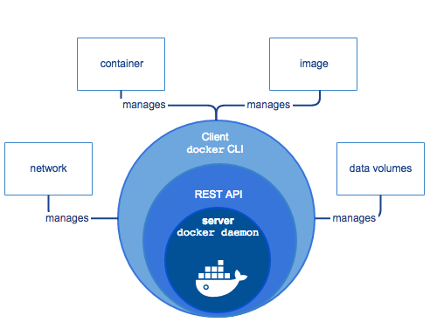
Basic Concepts
Docker Engine works as a client-server architecture. Docker daemon works as a server, which is the core part of Docker and is run on the host operating system. This service exposes some rest APIs that can be used by the client. A command line interface (CLI) client uses the services provided by Docker daemon with Docker command.

Slide 86
Important Terms
Image: Image is the executable application package file inside Docker. It contains everything needed to run an application, including libraries, config files, runtime, etc. It's a snapshot of a container.
Container: An instance of an image is called a container. When an image is executed and takes place in memory, then the instance of this image is called a container. It executes in a completely isolated environment.
In OOP terms, Image is a class, and a container is an instance of this class — a runtime object.
Registry: A registry is a storage and content delivery system that stores Docker images. Docker Hub is a popular Docker registry. We can store different versions of images with different tag numbers to Docker Hub.
Dockerfile: It's a text file that contains all the commands to assemble an image.
Dockerfile > (Build) > Image > (Run) > Container

Slide 87
Monitoring Spring Applications
Spring Boot Actuator
In essence, Actuator brings production-ready features to our application.
Monitoring our app, gathering metrics, understanding traffic, or the state of our database becomes trivial with this dependency.
The main benefit of this library is that we can get production-grade tools without having to actually implement these features ourselves.
Actuator is mainly used to expose operational information about the running application – health, metrics, info, dump, env, etc. It uses HTTP endpoints or JMX beans to enable us to interact with it.
Once this dependency is on the classpath several endpoints are available for us out of the box. As with most Spring modules, we can easily configure or extend it in many ways.

Slide 88
Spring Framework 5
Spring 5 is the first major release, almost four years after Spring Framework 4.0. During this time, most of the enhancements were done in Spring boot project.

Slide 89
Baseline upgrades
To build and run Spring 5 application, you will need minimum JDK 8 and Java EE 7. Previous JDK and Java EE versions are not supported anymore. To elaborate, Java EE 7 includes –
Servlet 3.1
JMS 2.0
JPA 2.1
JAX-RS 2.0
Bean Validation 1.1
Similar to Java baseline, there are changes in baselines of many other frameworks as well. e.g.
Hibernate 5
Jackson 2.6
EhCache 2.10
JUnit 5
Tiles 3
Also, note down the minimum supported versions of various servers.
Tomcat 8.5+
Jetty 9.4+
WildFly 10+
Netty 4.1+
Undertow 1.4+

Slide 90
Functional Programming with Kotlin
Spring Framework 5.0 introduces support for JetBrains Kotlin language. Kotlin is an object-oriented language supporting functional programming style.
Kotlin runs on top of the JVM, but not limited to it. With Kotlin support, developers can dive into functional Spring programming, in particular for functional Web endpoints and bean registration.

Slide 91
A functional web framework
Building on top of the reactive features, Spring 5 also provides a functional web framework. It provides features to define endpoints using functional programming style. This framework introduces two fundamental components: HandlerFunction and RouterFunction.
The HandlerFunction represents a function that handles incoming requests and generates responses. RouterFunction serves as an alternative to the @RequestMapping annotation. It’s used for routing incoming requests to handler functions. e.g.
RouterFunction<String> route =
route(GET("/hello-world"),
request -> Response.ok().body(fromObject("Hello World")))

Slide 92
Reactive programming support
Reactive programming is one of the most important features of Spring Framework 5.0. Reactive programming provides an alternate style of programming focused on building applications that react to events. Spring Framework 5 embraces Reactive Streams (language-neutral attempt to define reactive APIs) and Reactor (java implementation of Reactive Streams provided by the Spring Pivotal team) for its own reactive use as well as in many of its core APIs.
Spring Web Reactive lives in the new spring-web-reactive module next to the existing Spring Web MVC that lives in the spring-webmvc module.

Slide 93
What is reactive programming?
The term, “reactive,” refers to programming models that are built around reacting to changes. It is build around publisher-subscriber pattern (observer pattern). In reactive style of programming, we make a request for resource and start performing other things. When the data is available, we get the notification along with data inform of call back function. In callback function, we handle the response as per application/user needs.

Slide 94
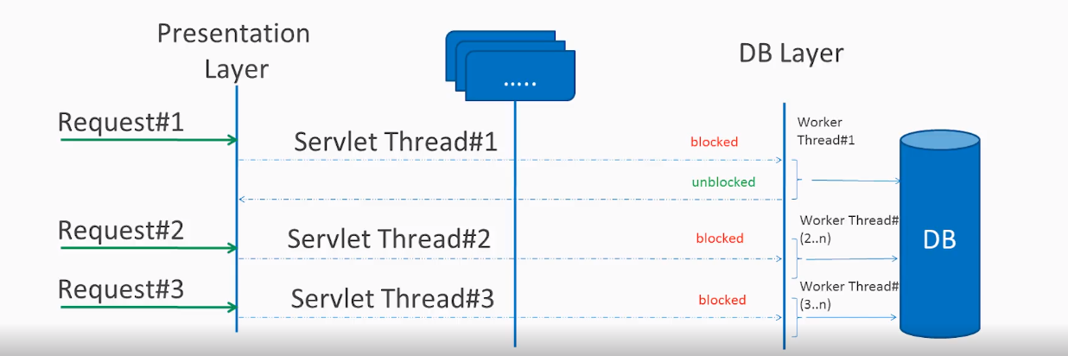
Blocking vs non-blocking (async) request processing

Slide 95
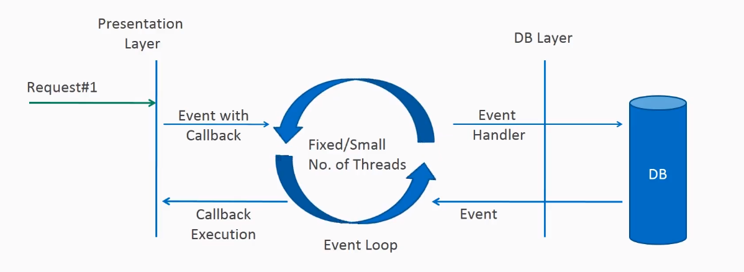
Non-blocking request processing

Slide 96
Reactive Streams API
Reactive Streams is a small specification intended to be implemented by the reactive libraries built for the JVM. It specifies the types to implement to achieve interoperability between different implementations. The specification defines the interaction between asynchronous components with back pressure. Reactive Streams was adopted in Java 9, by the Flow API. The purpose of the Flow API is to act as an interoperation specification and not an end-user API like RxJava.

Slide 97
Reactive Streams API Interfaces
Publisher: Emits a sequence of events to subscribers according to the demand received from its subscribers. A publisher can serve multiple subscribers.
Subscriber: Receives and processes events emitted by a Publisher. Please note that no notifications will be received until Subscription#request(long) is called to signal the demand.
Subscriber: Receives and processes events emitted by a Publisher. Please note that no notifications will be received until Subscription#request(long) is called to signal the demand.
Subscriber: Receives and processes events emitted by a Publisher. Please note that no notifications will be received until Subscription#request(long) is called to signal the demand.

Slide 98
Spring Cloud Microservices - Netflix OSS

Slide 99
Definition of Microservices
Microservices are one of the increasingly popular architecture patterns next to SOA (Services Oriented Architecture). If you are following industry trends, then you realize that today business houses are no longer interested in developing large applications to manage their end-to-end business functions as they did a few years ago, rather they opt for quick and agile applications which cost them less money as well.

Slide 100
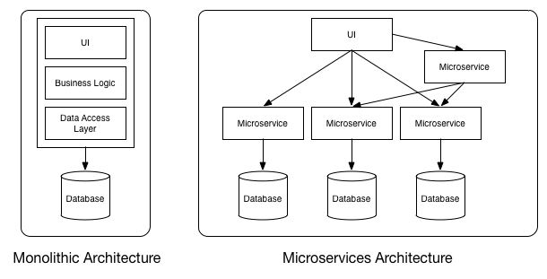

Slide 101
Principles of Microservices
Single responsibility principle
Built around business capabilities
You build it, you own it!
Infrastructure Automation
Design for Failure

Slide 102
Benefits of Microservices
With microservices, architects and developers can choose fit for purpose architectures and technologies
As services are fairly simple and smaller in size, enterprises can afford to experiment with new processes, algorithms, business logic, and so on.
Microservices enable to implement selective scalability i.e. each service could be independently scaled up or down and cost of scaling is comparatively less than monolithic approach.
Microservices are self-contained, independent deployment modules enabling the substitution of one microservice with another similar microservice, when the second one is not performing as per our need.
Microservices help us build systems that are organic in nature (Organic systems are systems that grow laterally over a period of time by adding more and more functions to it).
Technology changes are one of the barriers in software development. With microservices, it is possible to change or upgrade technology for each service individually rather than upgrading an entire application.
As microservices package the service runtime environment along with the service itself, this enables having multiple versions of the service to coexist in the same environment.

Slide 103
How we build microservice in Spring
For Spring a microservice is just another application that follows the Microservice Principles. To be able to get the most of the spring eco-system we have a few modules that will help us with the development:
Spring Cloud Configuration Server
Spring Cloud Eureka
Spring Cloud Hystrix
Spring Cloud Ribbon
Spring Cloud Sleuth and Zipkin
Spring Cloud Zuul

Slide 104
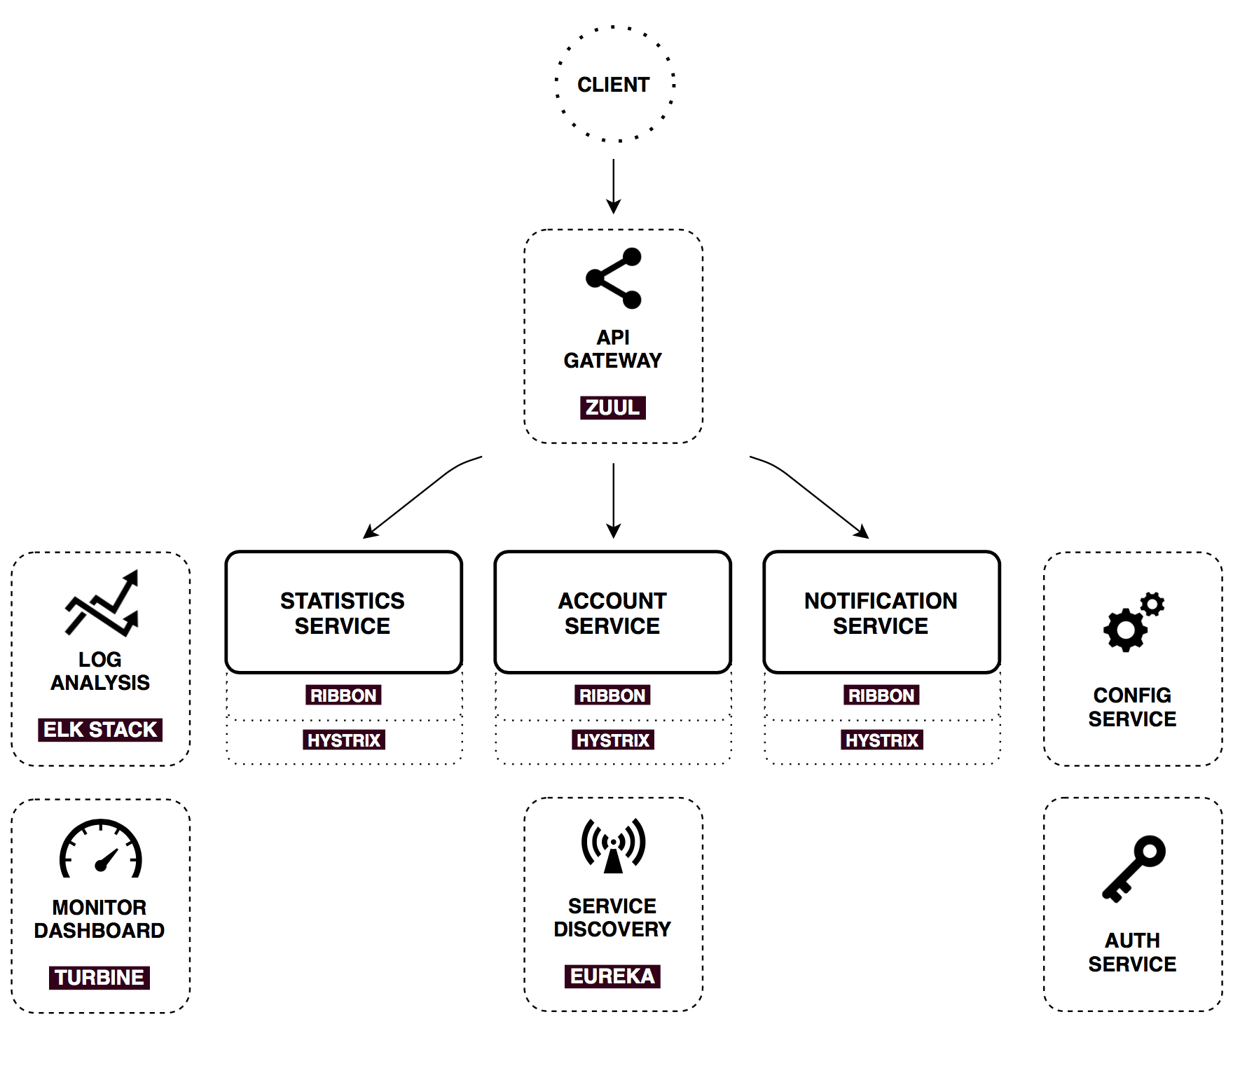

Slide 105
Spring Cloud Configuration Server
Spring Cloud Configuration Server is a centralized application that manages all the application related configuration properties.

Slide 106
Spring Cloud Eureka (Service Discovery)
Client-side service discovery allows services to find and communicate with each other without hard-coding hostname and port. The only ‘fixed point' in such an architecture consists of a service registry with which each service has to register.
A drawback is that all clients must implement a certain logic to interact with this fixed point. This assumes an additional network round trip before the actual request.

Slide 107
Spring Cloud Hystrix (Circuit Breaker)
Spring Cloud Netflix Hystrix. It is a fault tolerance library, which implements the Circuit Breaker enterprise pattern - a pattern designed to prevent cascading failures.
In a typical microservice architecture we have many small applications running separately. It's quite common that one service calls another service (may be more than one) to complete a particular request. There is always a possibility that one of these downstream services won't respond correctly or simply fails completely.

Slide 108
Spring Cloud Ribbon (Load Balancing)
Ribbon is a client-side load balancer that gives you a lot of control over the behavior of HTTP and TCP clients.
A central concept in Ribbon is that of the named client. Each load balancer is part of an ensemble of components that work together to contact a remote server on demand, and the ensemble has a name that you give it as an application developer. On demand, Spring Cloud creates a new ensemble as an ApplicationContext for each named client by using RibbonClientConfiguration. This contains (amongst other things) an LoadBalancer, a RestClient, and a ServerListFilter.

Slide 109
Spring Cloud Sleuth and Zipkin
Zipkin is very efficient tool for distributed tracing in microservices ecosystem. Distributed tracing, in general, is latency measurement of each component in a distributed transaction where multiple microservices are invoked to serve a single business usecase
Sleuth is a tool from Spring cloud family. It is used to generate the trace id, span id and add these information to the service calls in the headers and MDC, so that It can be used by tools like Zipkin and ELK etc. to store, index and process log files.

Slide 110
Spring Cloud Zuul (Routing)
In a typical microservice architecture we have many small applications running on different hosts and ports. The problem in this type of architecture is how clients (Web Applications in browsers, Mobile apps, Third-party apps making a web service call, etc.) can access these end microservices without knowing their hosts and ports.
What we need is a common entry point to our microservices. Using this, we not only free the clients from knowing deployment details about all of the backend services, but also reduce development effort on the server side. At the same time, if an end microservice has multiple instances running, we can do load balancing at this entry point.

Slide 111
Thank You
Q&A

